Slide 1


Introduction to Reproducible Science: Day 2
Nelson Roque, PhD
Scan for
Slides & Code available on GitHub
Notes:
Image: Illustration by @allison_horst, from Hadley Wickham’s talk “The Joy of Functional Programming (for Data Science)”

Slide 2
Agenda: Day 2
Data wrangling and visualization of Big Data
Skill 1: Data wrangling the Google Mobility dataset
Reproducible survey research
Qualtrics survey design tips
Skill 2: Data wrangling Qualtrics data
Working with JSON data
Skill 3: cleaning and visualizing keystroke JSON data

Slide 3
Skill 1: Data Wrangling & Visualization

Slide 4
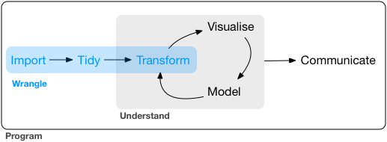
What is data wrangling?
The operations that carry your data from raw form, into something visualizable or analyzable
i.e., the data preparation phase of the research
Notes:
https://vita.had.co.nz/papers/tidy-data.pdf

Slide 5
What is tidy data?
Every column is a variable.
Every row is an observation.
Every cell is a single value.
participant | condition | avg_response_time | perc_accuracy
9991 | control | 506 | 90
9992 | active | 516 | 96
9993 | control | 526 | 99
Source: R for Data Science
Notes:
https://vita.had.co.nz/papers/tidy-data.pdf

Slide 6
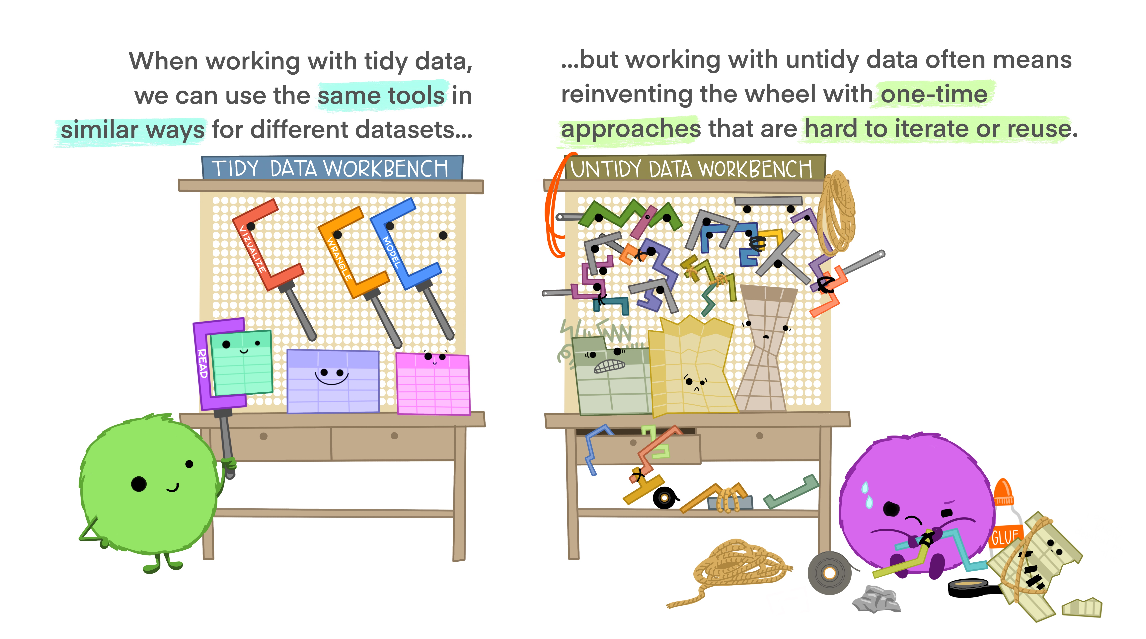
Notes:
Illustrations from the Openscapes blog Tidy Data for reproducibility, efficiency, and collaboration by Julia Lowndes and Allison Horst

Slide 7
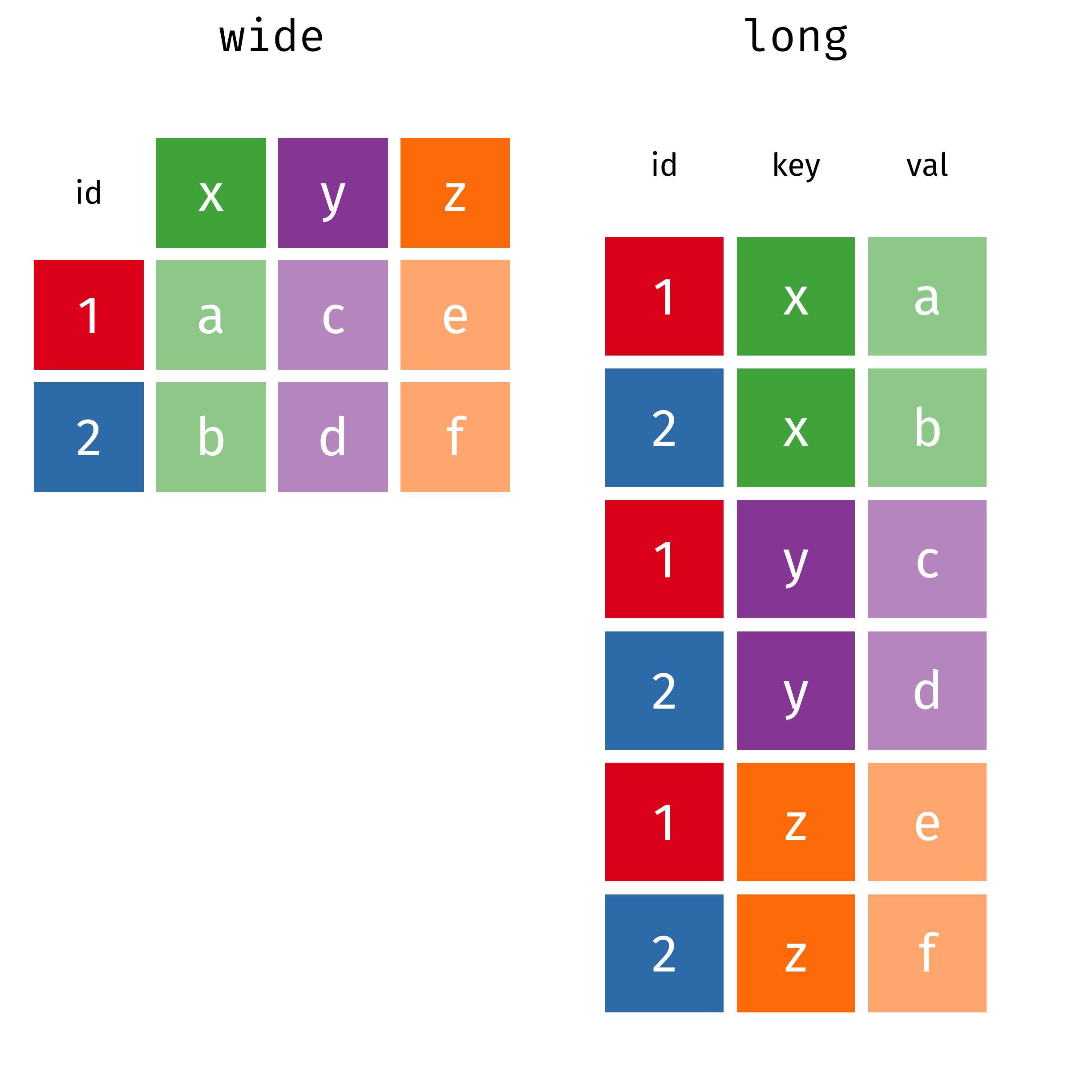
Typical data wrangling operations
Data exploration
Plotting, descriptive stats
Dealing with missing data
Impute missing data, insert missing codes (-999)
Reshaping data
Add columns (e.g., create flag is missing more than 10 records)
Update column names (id = participant_id)
Converting between long and wide format
Notes:
Graphics from: https://www.garrickadenbuie.com/project/tidyexplain/#usage
https://github.com/gadenbuie/tidyexplain

Slide 8
Typical data wrangling operations
Filtering data
Remove specific observations, by column or row
Merging/matching data from various sources
Join data by common id(s) in various ways (more on next slides)
https://dplyr.tidyverse.org/articles/two-table.html
Other wrangling
Feature engineering
E.g., Add ‘features’ of date as new columns (e.g., what is day of week for 10/13/2020)

Slide 9
Primer: dplyr + ggplot2 (part of the tidyverse)
dplyr
select() = select certain columns
contains(“timer”)
-contains(“timer”)
mutate() = append or modify a column
group_by() = group output of analysis by grouping factors
%>% = pipe (chaining operator)
ggplot2
geom_bar()
geom_point()
geom_line()
geom_histogram()
facet_grid, facet_wrap
theme_bw(), theme_minimal(), theme(element_text(angle=90, font-family=“Arial”))

Slide 10
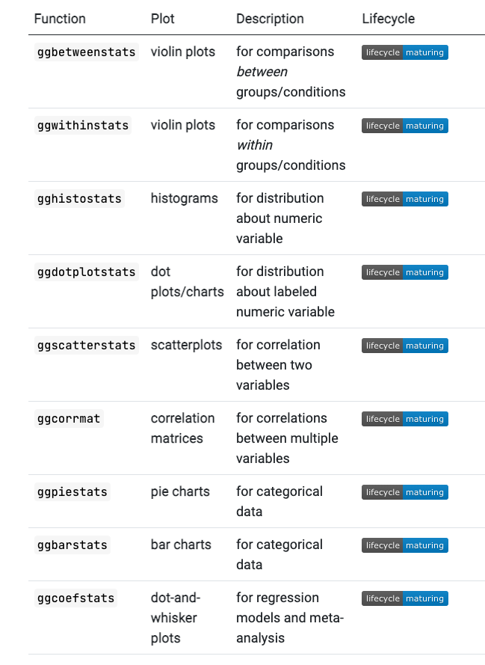
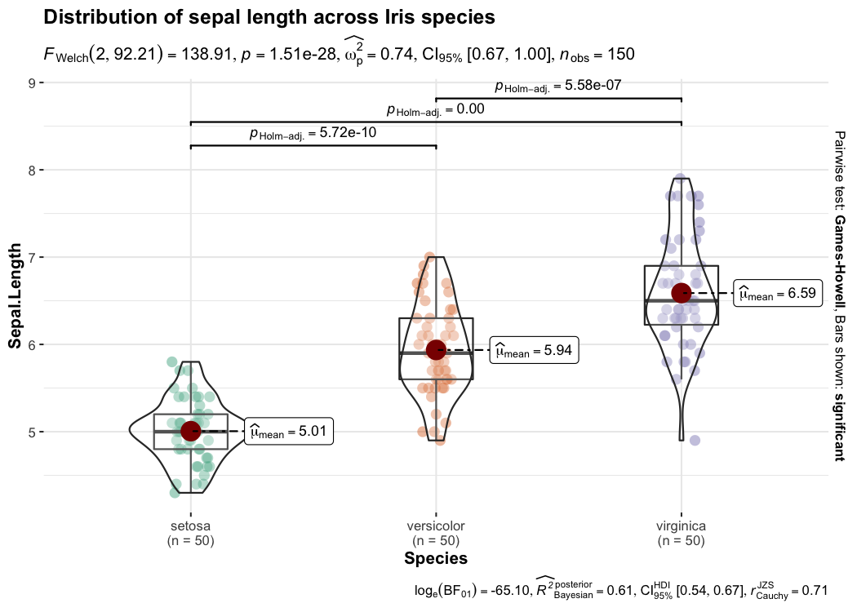
ggstatsplot
Notes:
https://indrajeetpatil.github.io/ggstatsplot/

Slide 11
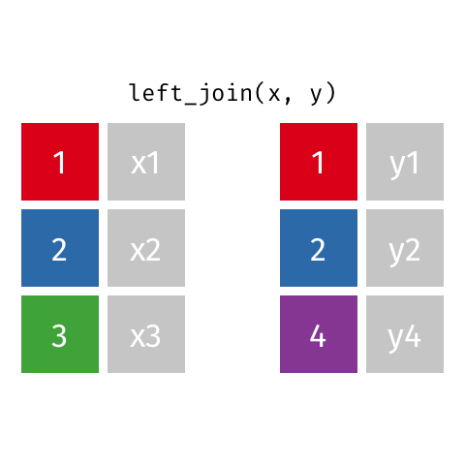
Joining data
Left join
All rows from x, and all columns from x and y. Rows in x with no match in y will have NA values in the new columns.
Notes:
Graphics from: https://www.garrickadenbuie.com/project/tidyexplain/#usage
https://github.com/gadenbuie/tidyexplain

Slide 12

Joining data
inner join
All rows from x where there are matching values in y, and all columns from x and y.
Notes:
Graphics from: https://www.garrickadenbuie.com/project/tidyexplain/#usage
https://github.com/gadenbuie/tidyexplain

Slide 13
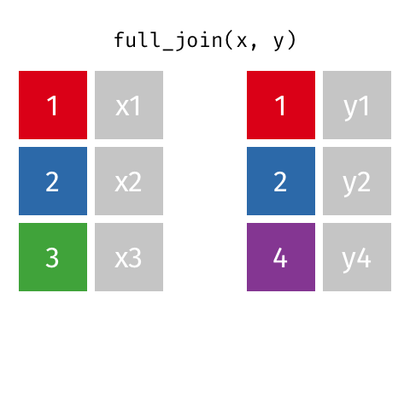
Joining data
full join
All rows and all columns from both x and y.
Where there are not matching values, returns NA for the one missing.
Notes:
Graphics from: https://www.garrickadenbuie.com/project/tidyexplain/#usage
https://github.com/gadenbuie/tidyexplain

Slide 14

Joining data
semi join
All rows from x where there are matching values in y, keeping just columns from x.
Basically filtering one dataframe, using another dataframe as the match.
Notes:
Graphics from: https://www.garrickadenbuie.com/project/tidyexplain/#usage
https://github.com/gadenbuie/tidyexplain

Slide 15

Joining data
anti join
Keeps all rows from x where there are not matching values in y, keeping just columns from x.
Find out which data is not joining, or may be missing from one or both datasets.
Notes:
Graphics from: https://www.garrickadenbuie.com/project/tidyexplain/#usage
https://github.com/gadenbuie/tidyexplain

Slide 16
Skill 1: Data Wrangling – Qualtrics Data

Slide 17
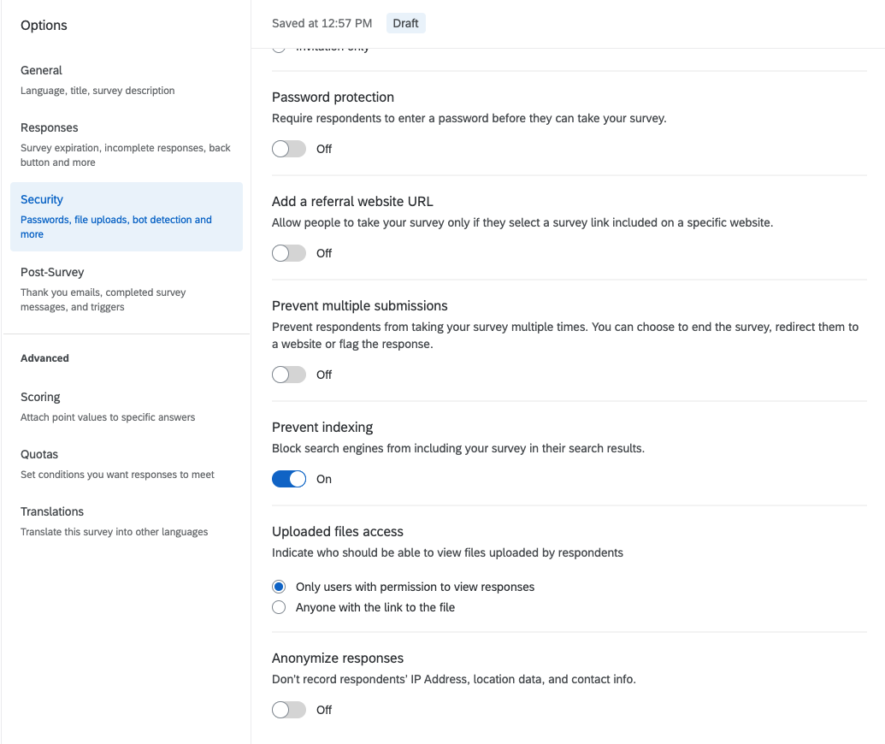
PSA – Anonymize your Qualtrics Surveys
By default, Qualtrics collects the following information
IP Address
Location data
Contact info (if provided)
Turn this off unless needed (and IRB aware)
Notes:
Demo survey to generate data for workshop: https://ucf.qualtrics.com/jfe/form/SV_9RnmgYsz6coyhca

Slide 18
Working with Qualtrics
The triple header problem
Solution: using the qualtRics package
qualtrics_df <- qualtRics::read_survey(filename)
Notes:
Demo survey to generate data for workshop: https://ucf.qualtrics.com/jfe/form/SV_9RnmgYsz6coyhca

Slide 19
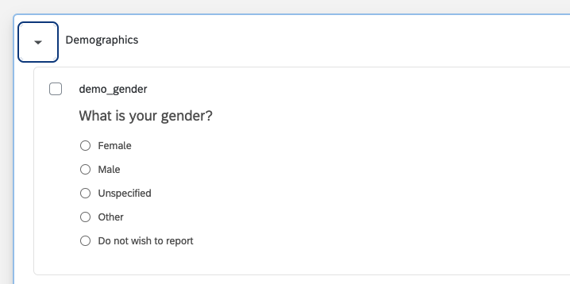
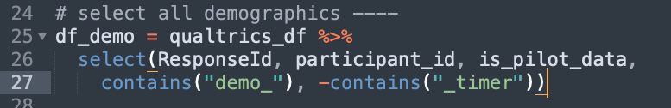
Working with Qualtrics
Survey bloat – finding what you need in a large survey
Solution: prefix questions with helpful identifiers for grouping ‘like’ questions
Downstream in R, can easily select columns of interest without typing all column names

Slide 20
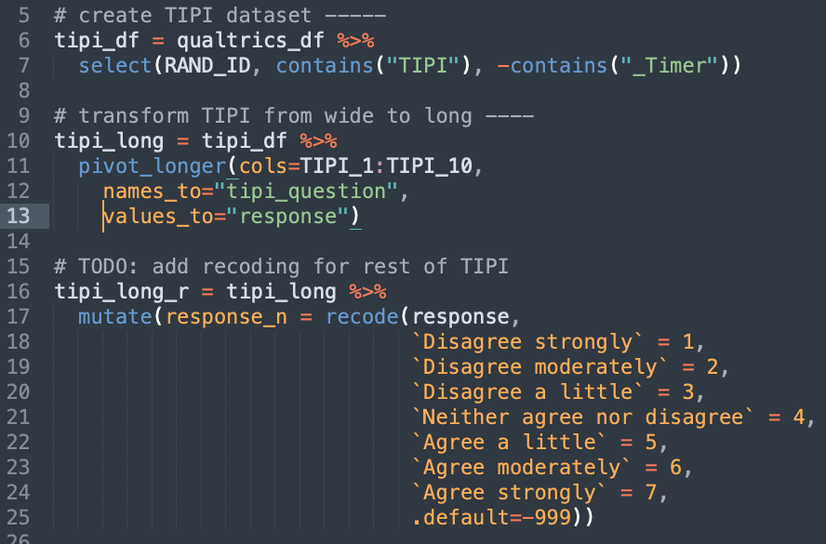
Working with Qualtrics Data in R
Recoding values similarly across many columns at once
Solution: convert data to long format, apply scoring on long-format data and then finally convert back to wide-format

Slide 21
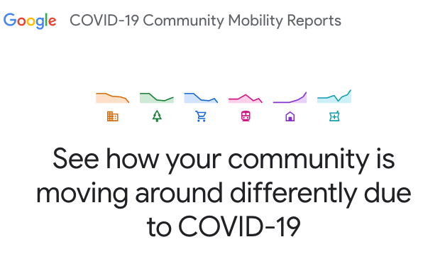
The Data Source: Google Mobility
Learn more about this data
https://www.google.com/covid19/mobility/data_documentation.html?hl=en

Slide 22
Let’s jump into R
Scan the QR code to view the code we will work with
Notes:
2-r-basics.Rmd

Slide 23
Skill 3: Data Wrangling – JSON data

Slide 24
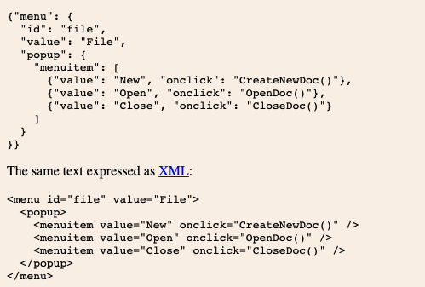
What is JSON?
JavaScript Object Notation
Lightweight format for storing and transporting data (similar to csv)
Often used when data is sent from a server to a web page
"self-describing" and easy to understand
https://www.w3schools.com/whatis/whatis_json.asp

Slide 25
JSON Syntax Rules
Data is in name/value pairs
Data is separated by commas
Curly braces hold objects
Square brackets hold arrays
https://www.w3schools.com/whatis/whatis_json.asp

Slide 26
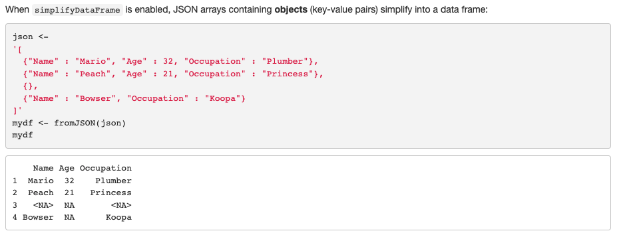
Working with JSON in R
library(jsonlite)
https://cran.r-project.org/web/packages/jsonlite/vignettes/json-aaquickstart.html

Slide 27
Let’s jump into R
Scan the QR code to view the code we will work with
Notes:
2-r-basics.Rmd

Slide 28
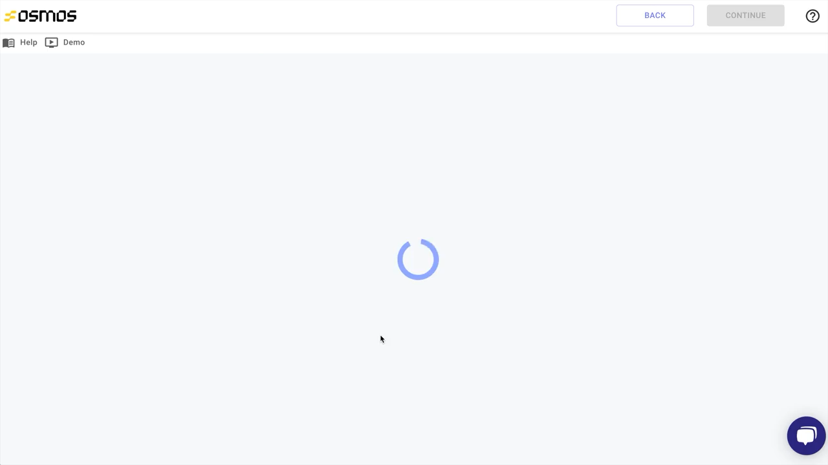
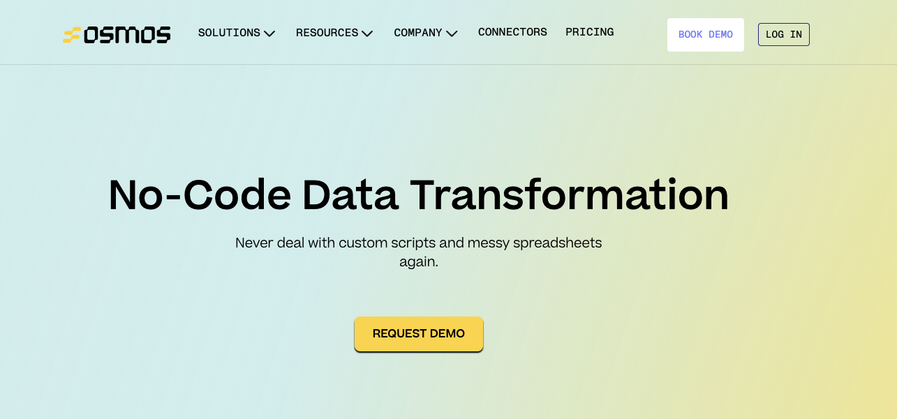
No-code data transformation

Slide 29
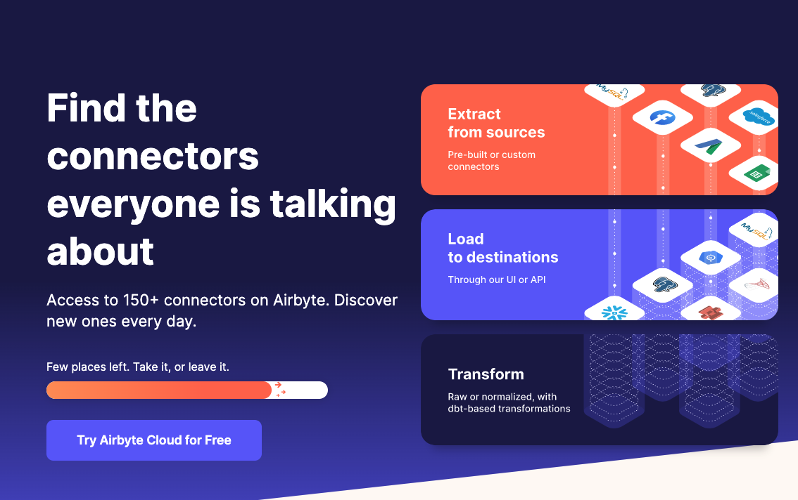
No-code data transformation

Slide 30
Download Cheatsheets
Data Import
https://github.com/rstudio/cheatsheets/raw/master/data-import.pdf)
Data Wrangling Cheatsheet
https://www.rstudio.com/wp-content/uploads/2015/02/data-wrangling-cheatsheet.pdf)
Data Transformation with dplyr
https://github.com/rstudio/cheatsheets/raw/master/data-visualization.pdf)
String Manipulation
https://github.com/rstudio/cheatsheets/raw/master/strings.pdf)
Work with dates/times
https://github.com/rstudio/cheatsheets/raw/master/lubridate.pdf)

Slide 31
Agenda: Day 3
Text mining
Skill 1: word and bigram frequency analysis
Skill 2: generating wordclouds
Skill 3: sentiment analysis
Interacting with APIs and JSON data
Skill 4: querying API for results and data aggregation
Closing Discussion & Q/A

Slide 32









nelson.roque@ucf.edu
nelsonroque.com
https://github.com/nelsonroque
thank
you

